Slide 1
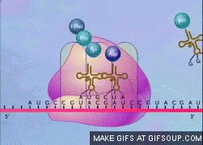
Protein Synthesis
ATHBY Human Biology

Slide 2
Review
Where is DNA located within the cell?
Draw a labelled diagram of a nucleotide, showing the 5’and 3’.
Name the four nitrogenous bases found in DNA.
Outline the steps of DNA replication, identifying the enzyme at each step.

Slide 3
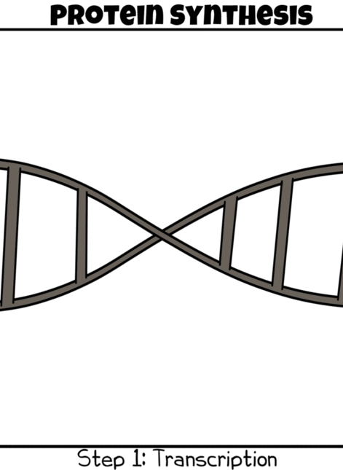
Learning Intentions
Protein synthesis involves the transcription of a gene on DNA into messenger RNA in the nucleus, and translation into an amino acid sequence at the ribosome with the aid of transfer RNA.

Slide 4
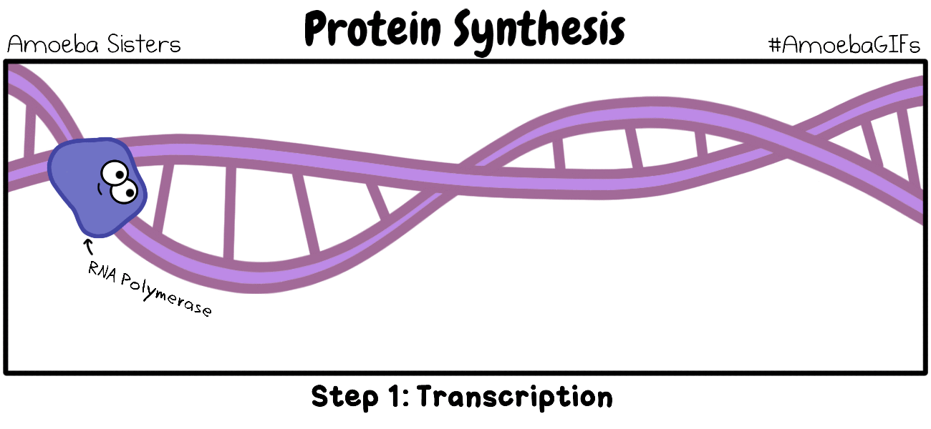
Success criteria
Describe the process of protein synthesis.
Describe three types of RNA.
Compare and contrast DNA and RNA.
Compare and contrast DNA replication and protein synthesis.
Compare and contrast transcription and translation.

Slide 5
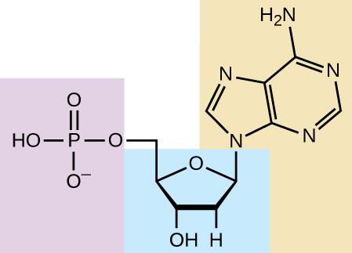
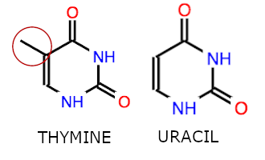
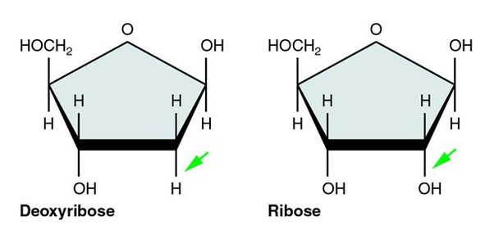
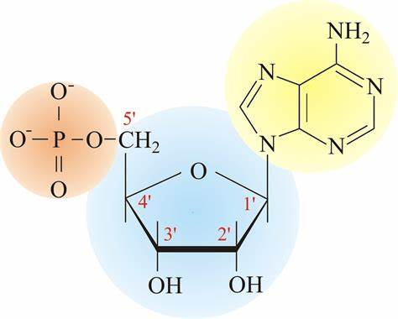
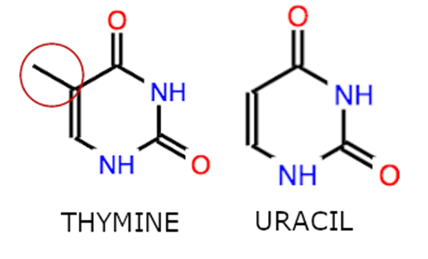

Ribonucleic acid (RNA)
Sugar is ribose, not deoxyribose.
Single stranded rather than double stranded.
Uracil base replaces Thymine (complementary to Adenine) (allows RNA to exist outside the nucleus, which DNA can’t)
Folds onto itself (hydrogen bonds between complementary bases) to make complex shapes

Slide 6
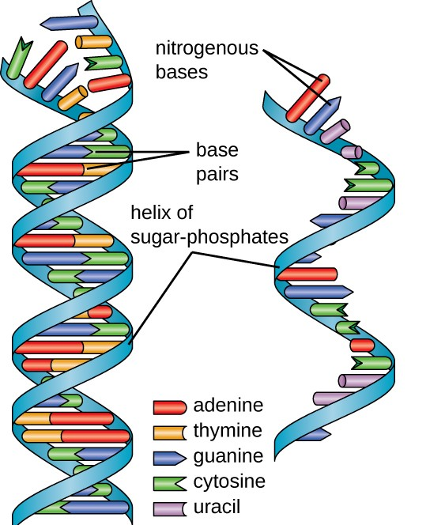
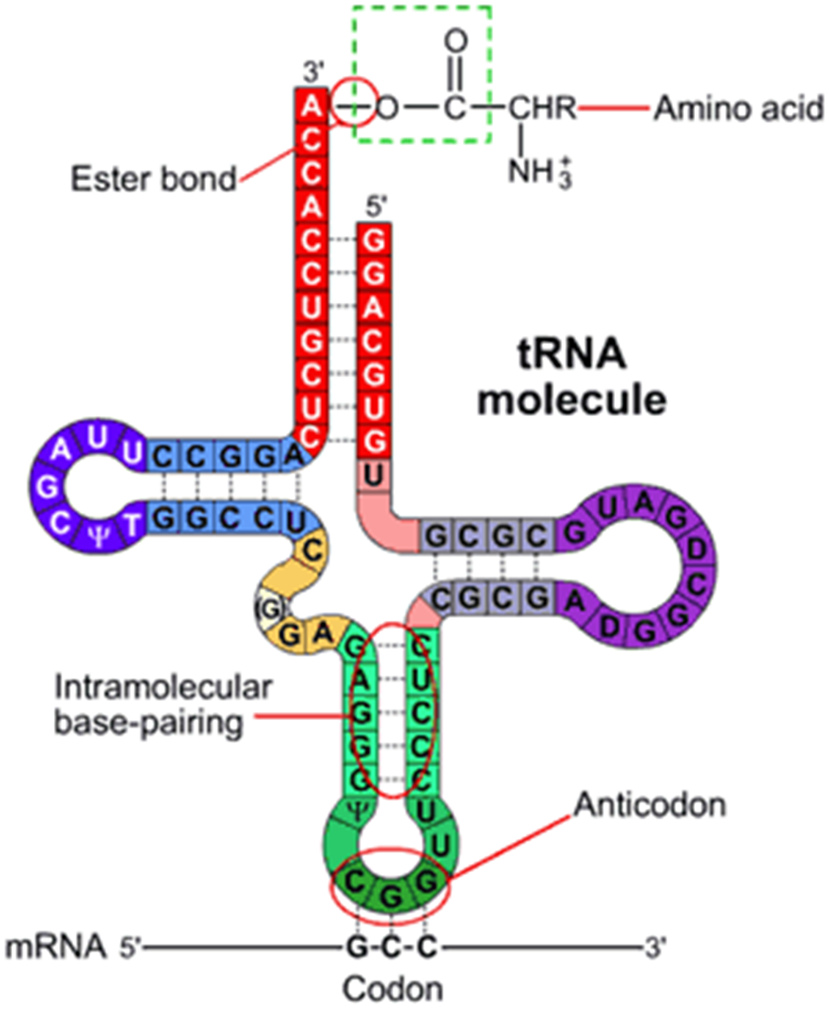
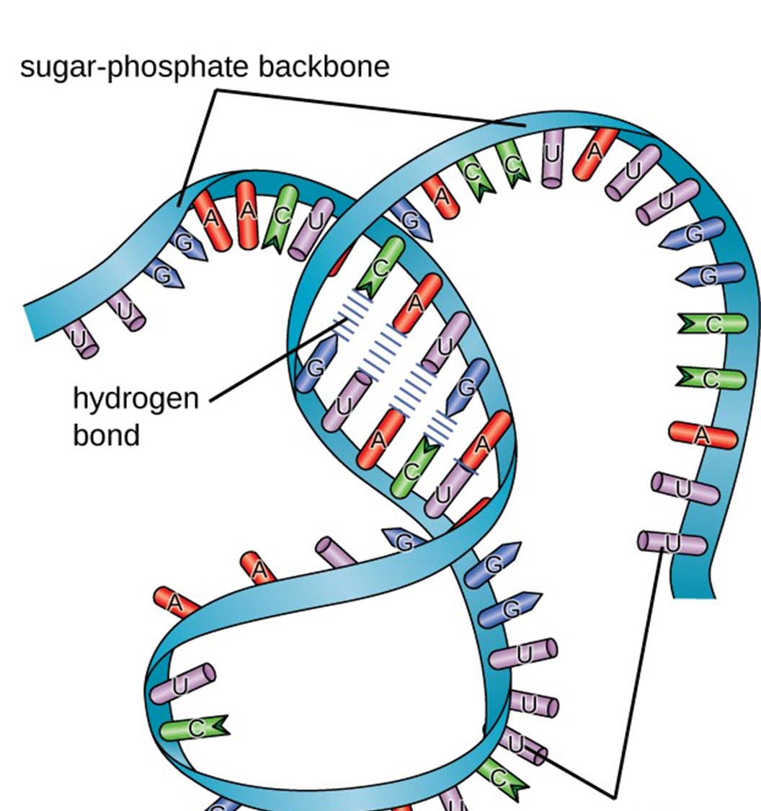

Slide 7
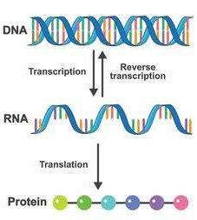
Protein synthesis

Slide 8
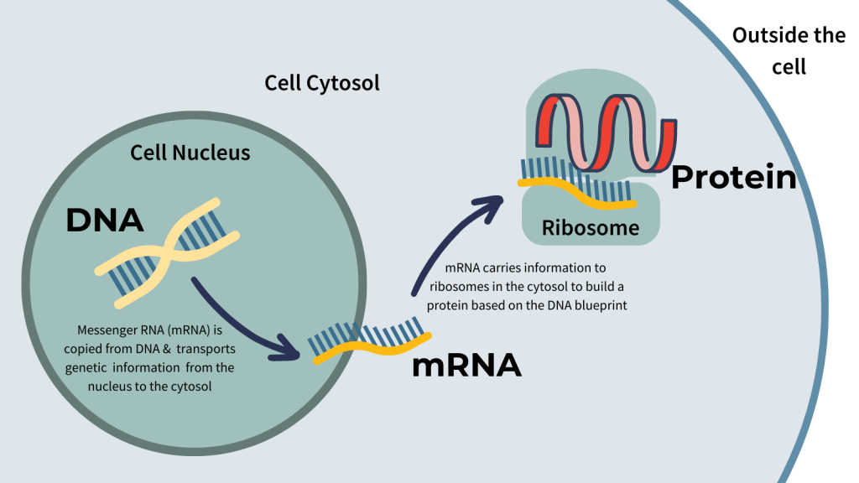
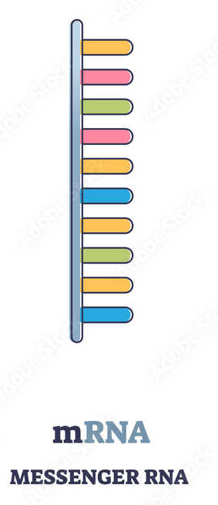
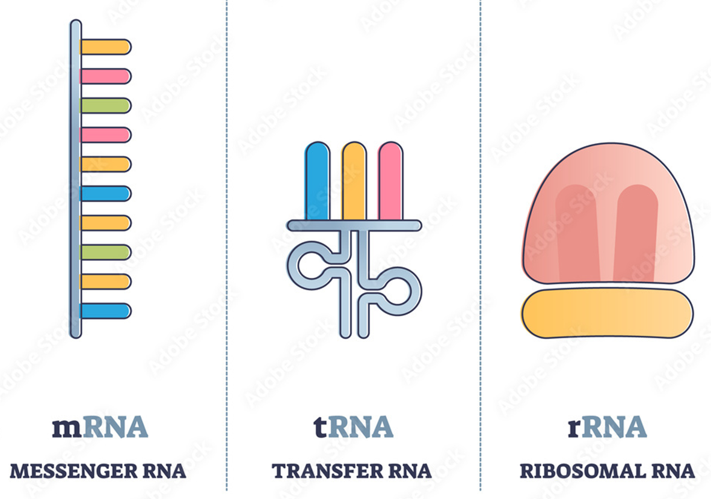
Types of RNA
Messenger RNA (mRNA) made in the nucleus and takes code out of the nucleus to be read by ribosomes.
Transfer RNA (tRNA) carries a specific amino acid for assembly in the ribosome.
Ribosomal RNA (rRNA) has an enzyme role in joining of amino acids.

Slide 9
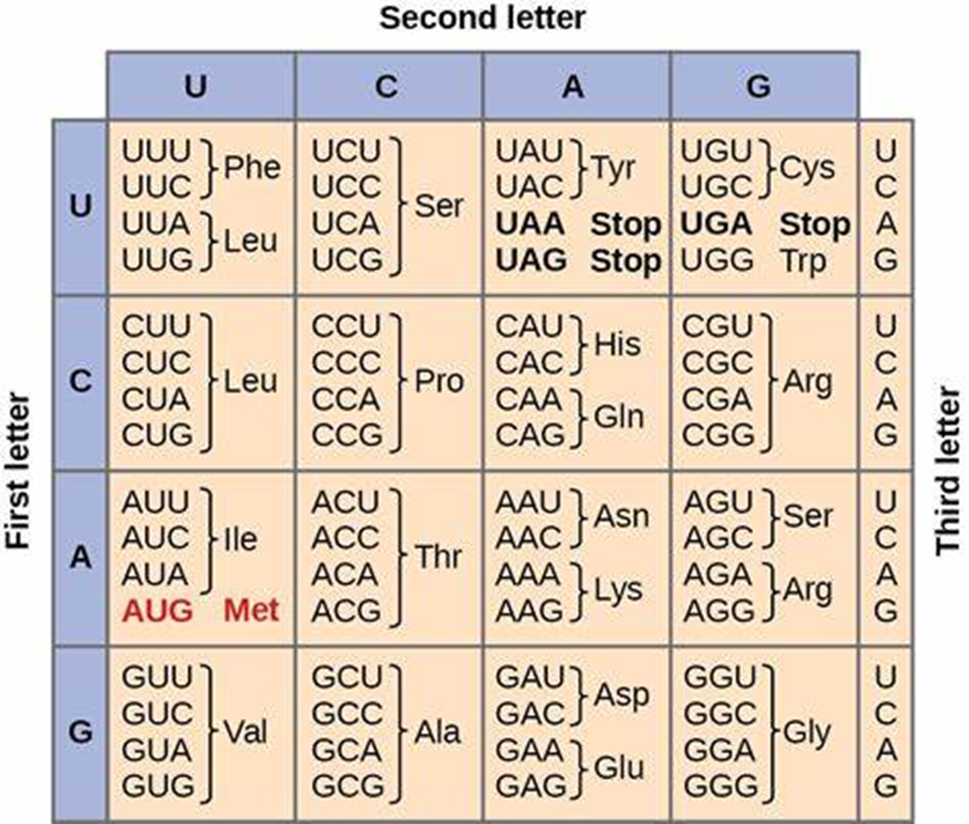
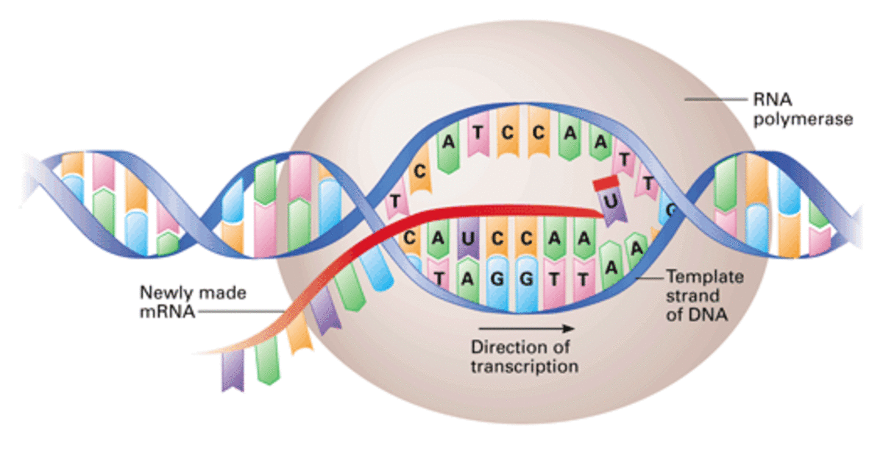
Transcription: Copying DNA to mRNA
Helicase unzips the DNA strand to reveal the template strand (original) and the coding strand (complementary).
RNA polymerase builds the mRNA on the template strand one complementary base at a time.
“Stop code” allows RNA polymerase to stop copying and release mRNA.

Slide 10
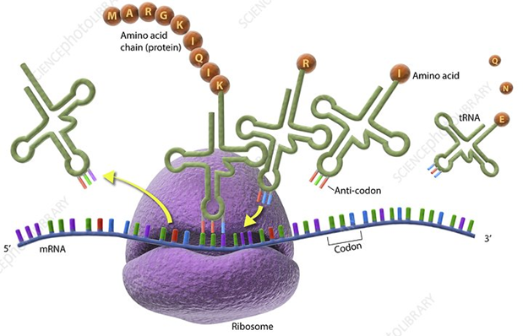
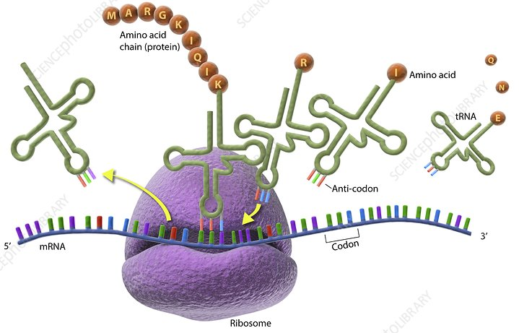
Translation(protein production)
Ribosome connects to a start codon on the mRNA
Ribosome moves along, reading one codon (3 bases) at a time.
As the ribosome reads the codon, the tRNA with the correct bases join to the mRNA.
Once the mRNA has delivered its bases, it detaches and moves back to collect more bases from the cytosol.

Slide 11
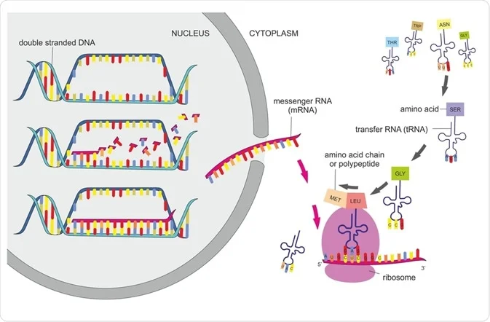
Transcription
Translation

Slide 12
Lipid and carbohydrate synthesis
There are no genes that carry instructions for assembly of lipids or carbohydrates, but these are controlled by very specific enzymes. Genes code for each specific enzyme (proteins), so indirectly genes do control lipid and carbohydrate synthesis.

Slide 13
BioMan Biology

Slide 14
Success criteria
Describe the process of protein synthesis.
Describe three types of RNA.
Compare and contrast DNA and RNA.
Compare and contrast DNA replication and protein synthesis.
Compare and contrast transcription and translation.

